Slide 1

Capstone project: Crime Data Analysis with MySQL and Python
RAMKUMAR Sembaiyan –s9034

Slide 2
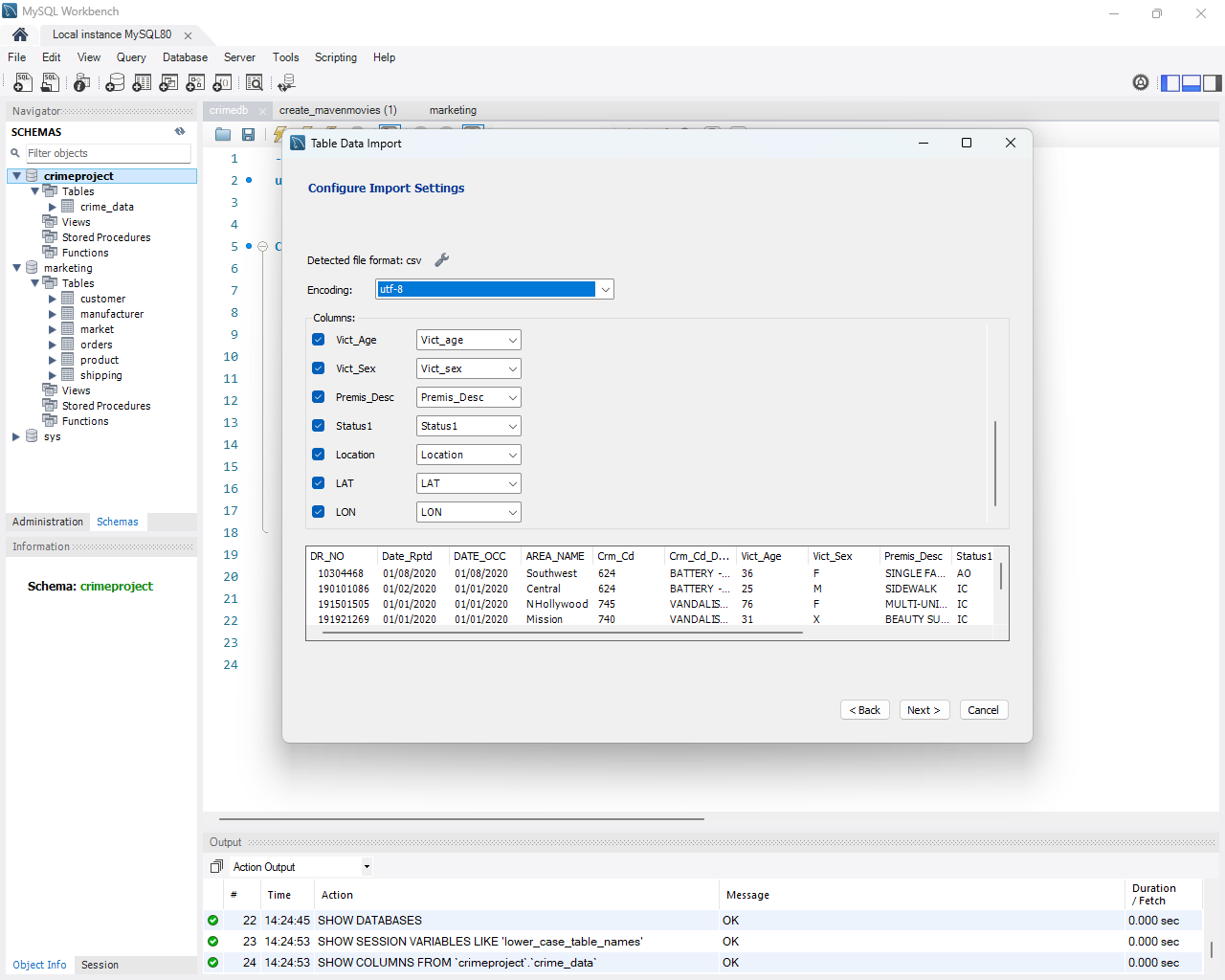
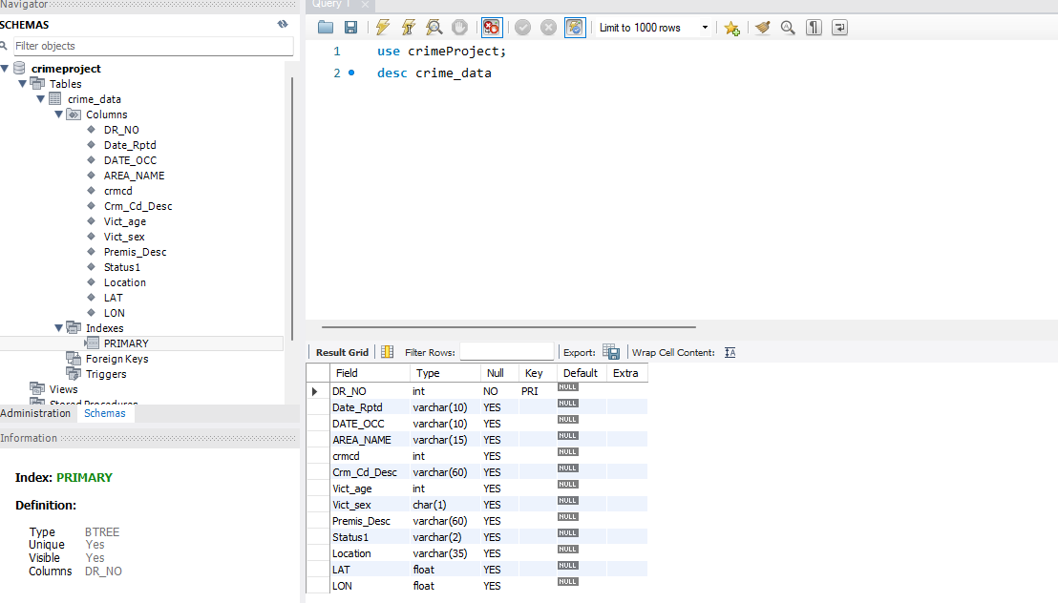
Database Setup and Import :
MYSQL DB:
Database name :crimeproject (newly created in local)
Table : crime_data (newly created)
Data Load
Csv file (provided) – crime_data.csv
Used MySql workbench Table Data import wizard (screenshot)

Slide 3
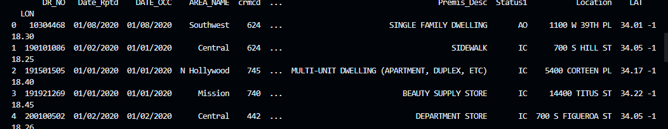
Database Connection :
pymysql module is used for connecting the DB and fetch the data from crime_data table.
VScode editor is used for developing python script
try:
connection=pymys.Connection(host='localhost',port=3306,user='root',password='y2024',database='crimeproject')
cursor=connection.cursor()
sql="Select * from crime_data"
cursor.execute(sql)
result=cursor.fetchall()
# Get column names
column_names = [desc[0] for desc in cursor.description] # Extract column names from description
if cursor:
cursor.close()
if connection:
connection.close()
df = pd.DataFrame(result, columns=column_names)
print(df.head())

Slide 4
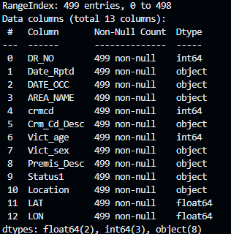
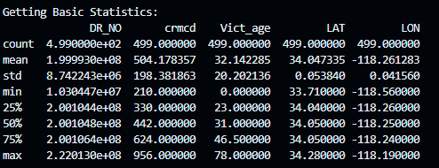
Data Exploration (Basic Statistics)
Used Pandas libraries and functions(info(),describe()) to explore basic validation
- Basic info and statistics

Slide 5
Data Exploration (cont)
Index Crime code Crime Description
0 624 BATTERY - SIMPLE ASSAULT
2 745 VANDALISM - MISDEAMEANOR ($399 OR UNDER)
3 740 VANDALISM - FELONY ($400 & OVER, ALL CHURCH VA...
4 442 SHOPLIFTING - PETTY THEFT ($950 & UNDER)
5 946 OTHER MISCELLANEOUS CRIME
6 341 THEFT-GRAND ($950.01 & OVER)EXCPT,GUNS,FOWL,LI...
7 330 BURGLARY FROM VEHICLE
8 930 CRIMINAL THREATS - NO WEAPON DISPLAYED
10 648 ARSON
12 230 ASSAULT WITH DEADLY WEAPON, AGGRAVATED ASSAULT
16 350 THEFT, PERSON
19 310 BURGLARY
22 480 BIKE - STOLEN
24 623 BATTERY POLICE (SIMPLE)
26 440 THEFT PLAIN - PETTY ($950 & UNDER)
35 510 VEHICLE - STOLEN
39 210 ROBBERY
47 888 TRESPASSING
63 761 BRANDISH WEAPON
69 420 THEFT FROM MOTOR VEHICLE - PETTY ($950 & UNDER)
108 421 THEFT FROM MOTOR VEHICLE - ATTEMPT
112 647 THROWING OBJECT AT MOVING VEHICLE
127 354 THEFT OF IDENTITY
132 662 BUNCO, GRAND THEFT
162 220 ATTEMPTED ROBBERY
164 625 OTHER ASSAULT
166 755 BOMB SCARE
214 900 VIOLATION OF COURT ORDER
231 320 BURGLARY, ATTEMPTED
266 901 VIOLATION OF RESTRAINING ORDER
294 956 LETTERS, LEWD - TELEPHONE CALLS, LEWD
339 920 KIDNAPPING - GRAND ATTEMPT
358 850 INDECENT EXPOSURE
364 666 BUNCO, ATTEMPT
380 351 PURSE SNATCHING
395 343 SHOPLIFTING-GRAND THEFT ($950.01 & OVER)
446 890 FAILURE TO YIELD
450 886 DISTURBING THE PEACE
452 649 DOCUMENT FORGERY / STOLEN FELONY
483 820 ORAL COPULATION
490 812 CRM AGNST CHLD (13 OR UNDER) (14-15 & SUSP 10 ...
491 940 EXTORTION
Distinct crime codes and their descriptions
# Get unique values in a specific column (e.g., 'crmcd')
unique_crime_codes = df.drop_duplicates(subset='crmcd')
print(f"Distinct crime codes with Descirption: \n {unique_crime_codes[['crmcd','Crm_Cd_Desc']]}") #uncooment
print()

Slide 6
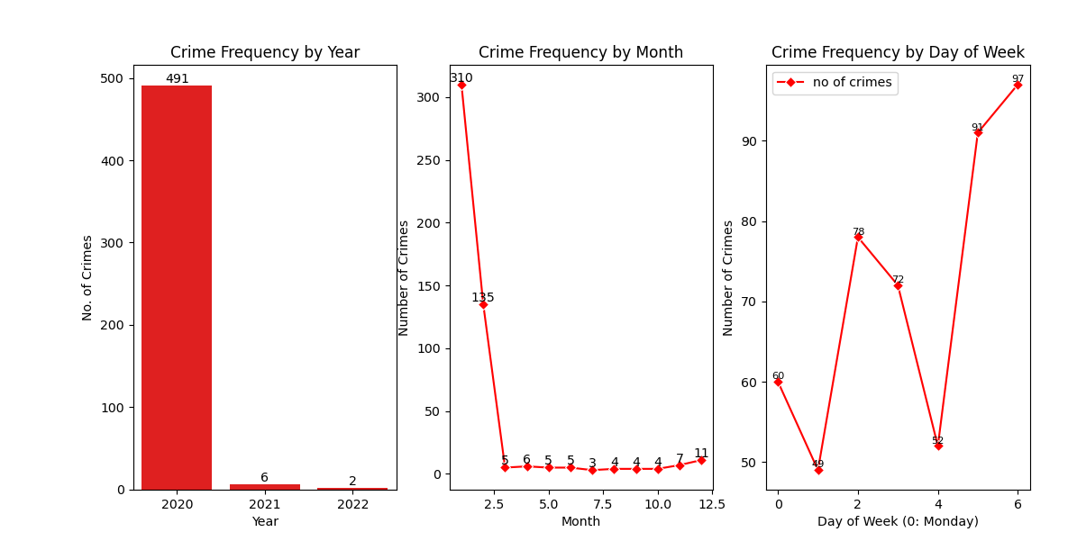
Temporal Analysis
Crime Frequency by Year:
There is a clear downward trend in the number of crimes reported over the years 2020, 2021, and 2022.
The number of reported crimes decreased from approximately 491 in 2020 to nearly 2 in 2022.
Crime Frequency by Month:
The month with the highest number of reported crimes is January, with a peak of around 310 crimes reported.
Conversely, July has the fewest reported crimes, at around 3.
Crime Frequency by Day of Week:
Sundays and Saturdays have the highest number of reported crimes, with over 90 crimes reported on those days.
Monday tend to have the fewest reported crimes, at around 60.

Slide 7
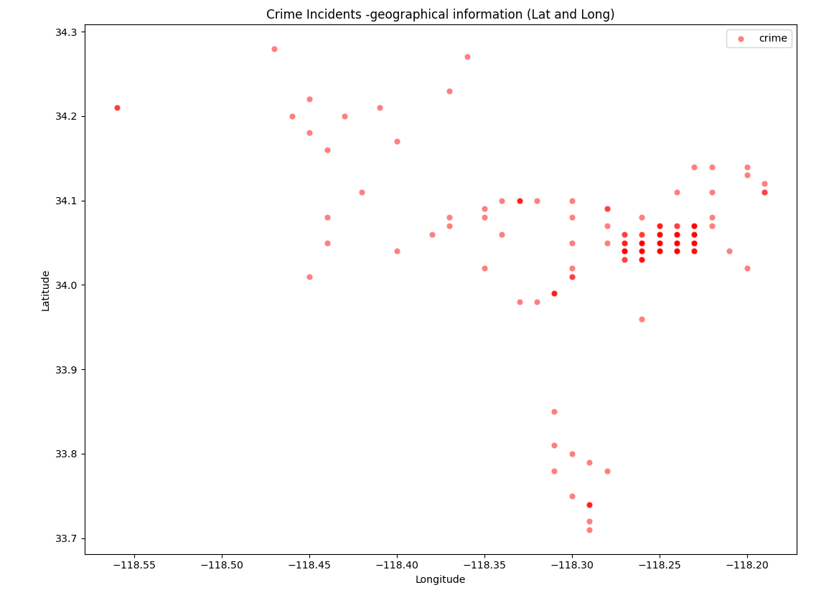
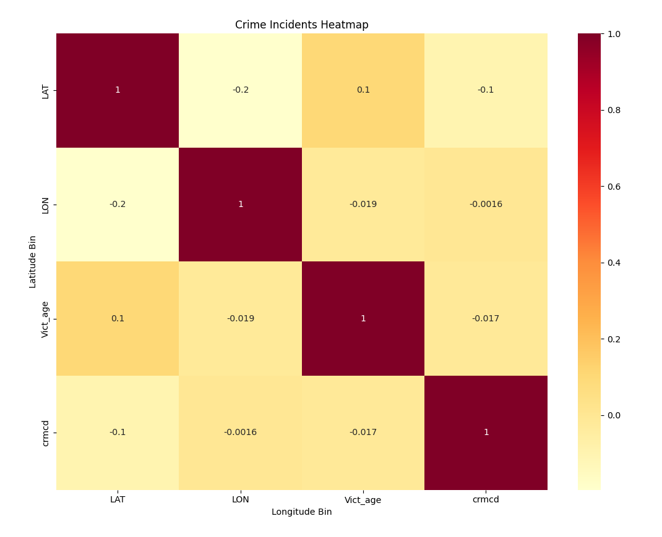
Spatial Analysis:

Slide 8
Spatial Analysis: (contd..)
Data Reveals Potential Hotspots:
Scattered data points show denser concentrations in specific areas, suggesting a higher frequency of crimes in those locations
Hot spot appears on the range of -118.2(long) and 34.1(lat).
Hotspot Identification:
Further spatial analysis techniques, can pinpoint statistically significant crime clusters.
Targeted Strategies: I
Identifying these hotspots allows for targeted crime prevention strategies and resource allocation to high-risk areas.

Slide 9
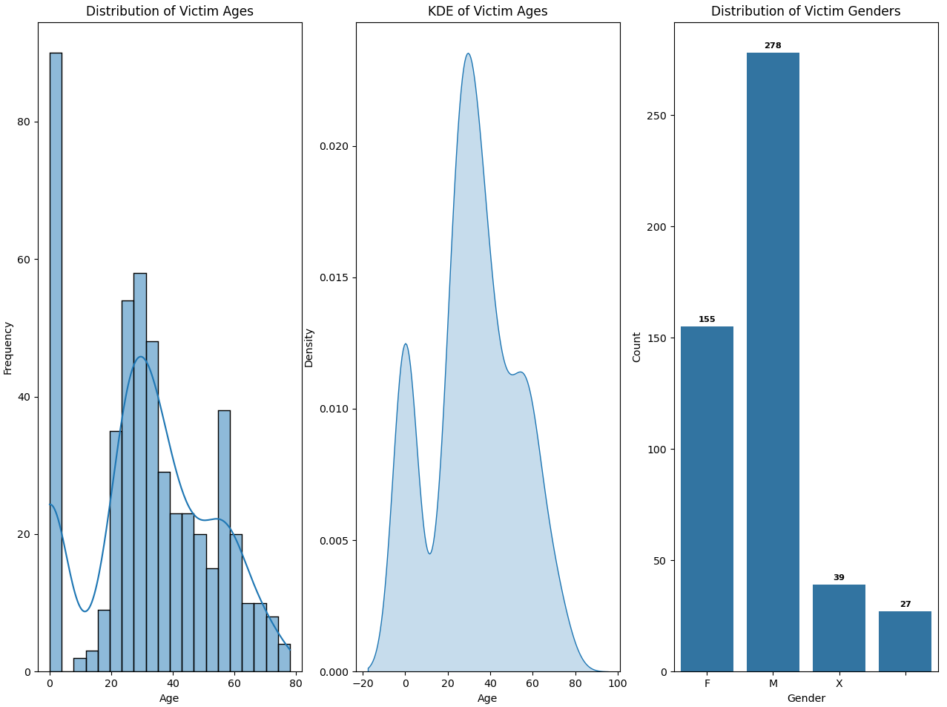
Victim Demographics:

Slide 10
Victim Demographics (contd)
1. Age Group with Highest Frequency:
The data suggests that the age group with the highest number of victims is 25-35 yrs as evidenced by the peak in the histogram
2. Age Distribution Pattern:
There is a trend of increased victimization rates across 20-30 years of age. There also a peak at the age <1. For validation we can consider this as outliers.
3. Gender Proportion:
The data indicates that 278 of victims are male, while 155 are Females. X - 39 and unspecified -27
4. Gender Difference:
There is a significant difference in the number of victims between males and females. Males account for a higher proportion [278] of victims.

Slide 11
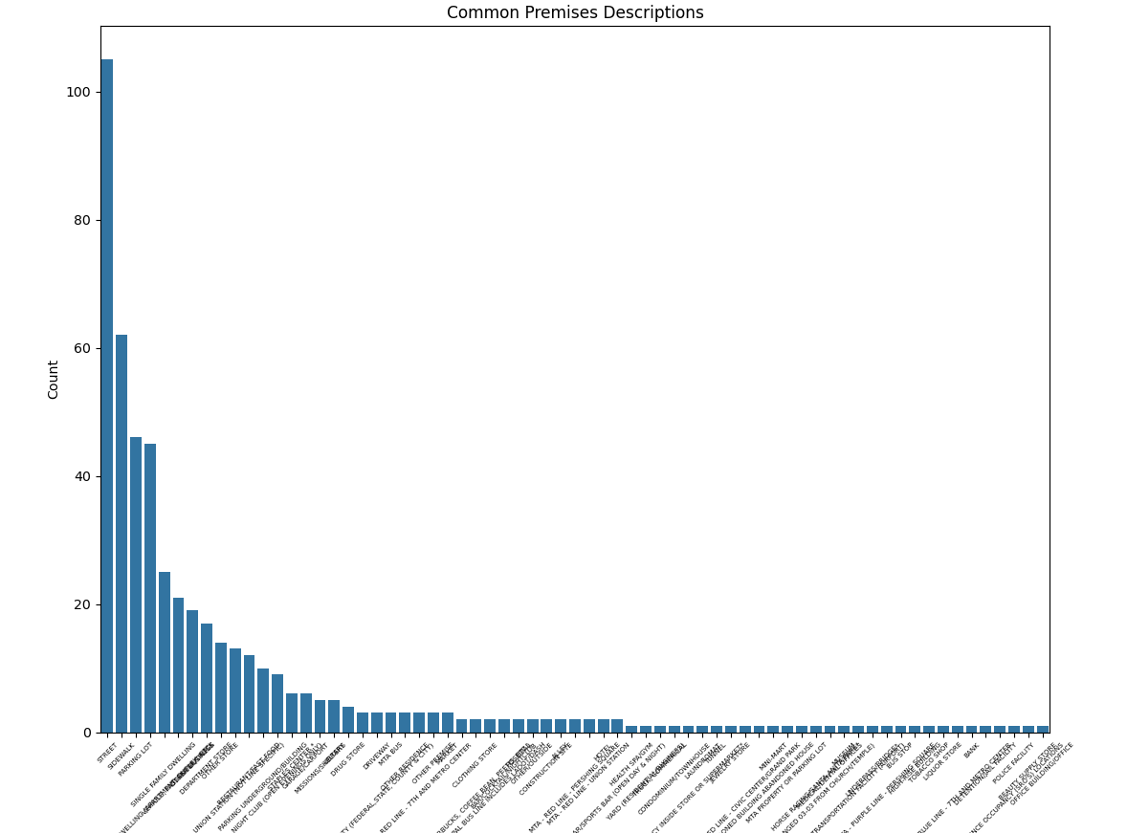
Victim Demographics (common premises)
Common premises where crime occur – Street,
Sidewalk,
Parking lot
(reference – Bar plot (premises desc vs count))

Slide 12
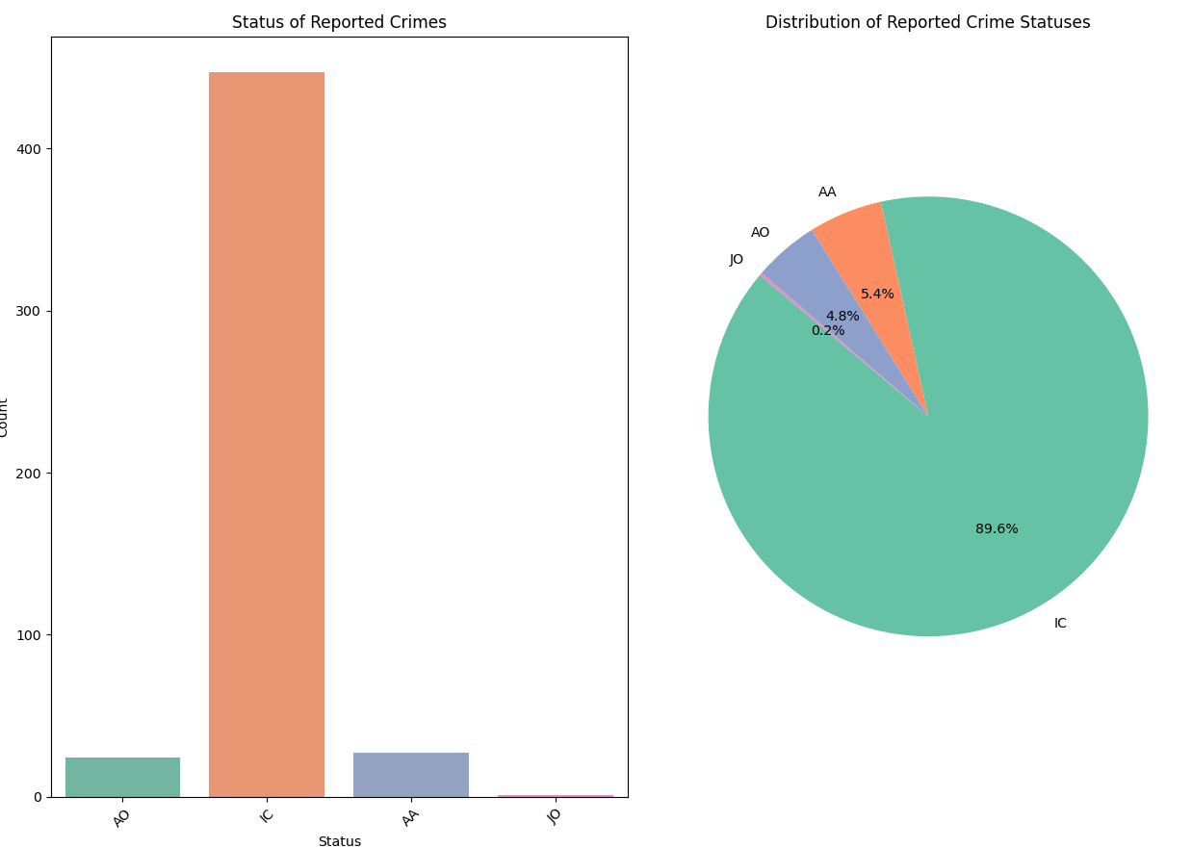
Status Analysis:

Slide 13
Status Analysis: (contd..)
Based on the pie chart distribution:
Inactive Case (IC) :89.6 %
Active Arrest (AA) :5.4 %
Assigned Officer (AO) :4.8%
Juvenile Offence (JO) :0.3 %

Slide 14
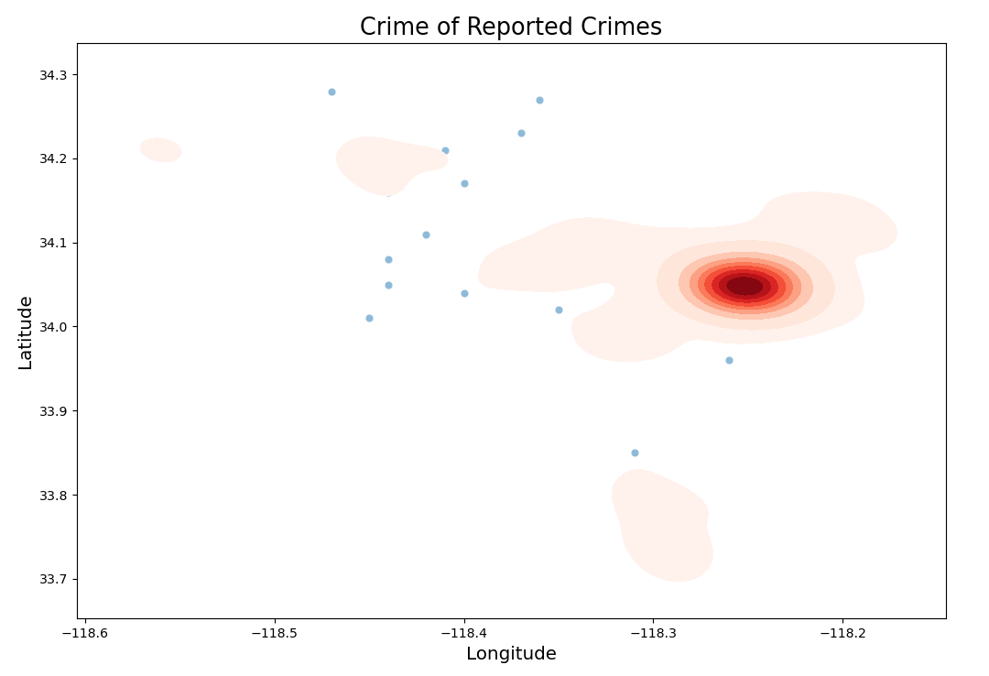
Question (Spatial)
Q: Where are the geographical hotspots for reported crimes?
A : The geographical hotspot for reported crimes appears to be around the longitude range -118.3 to -118.2. The heatmap shows a concentrated area with a deep red color, indicating a high density or clustering of crime incidents around that longitude value.
While the latitude range covers values from around 34.0 to 34.1

Slide 15
Question (Victim Demographics)
Q:What is the distribution of victim ages in reported crimes?
1. Age Group with Highest Frequency:
The data suggests that the age group with the highest number of victims is 25-35 yrs as evidenced by the peak in the histogram
2. Age Distribution Pattern:
There is a trend of increased victimization rates across 20-30 years of age. There also a peak at the age <1. For validation we can consider this as outliers.
Q: Is there a significant difference in crime rates between male and female victims?
There is a significant difference in the number of victims between males and females. Males account for a higher proportion [278] of victims.

Slide 16
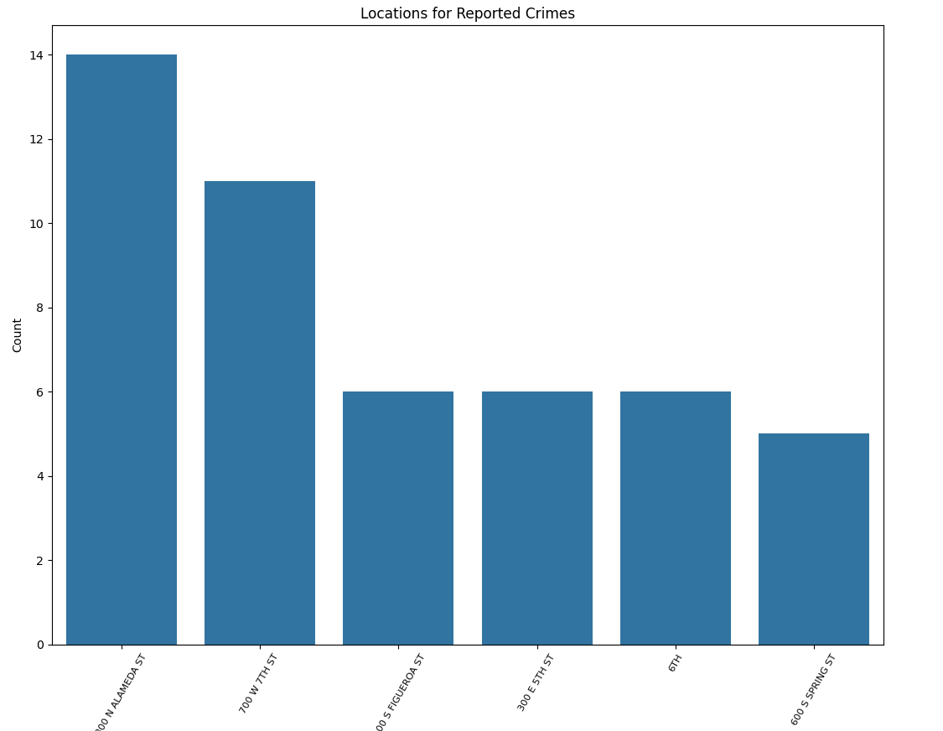
Question (Location Analysis)
Q:Where do most crimes occur based on the "Location" column?
The location for reported barplot cleary shows that most of the crime occurs in '800 N Alameda street' with 14 crimes

Slide 17
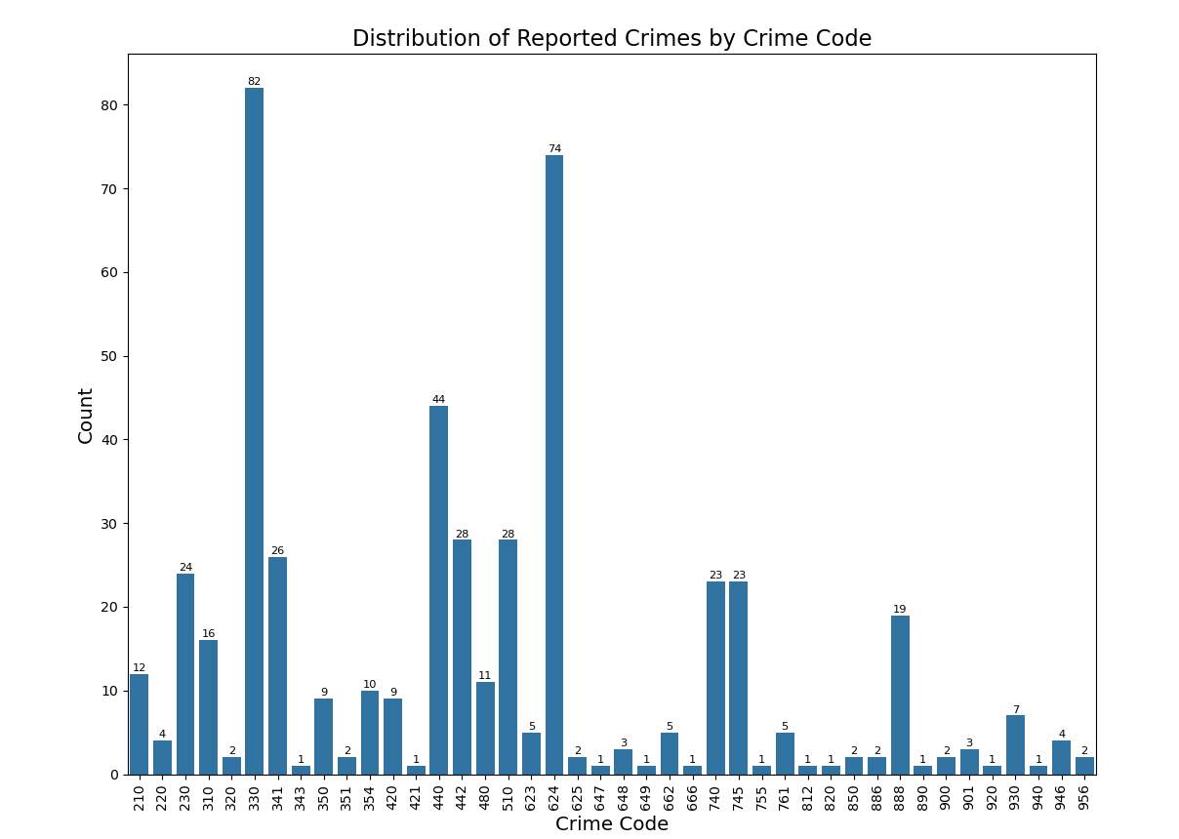
Question (Crime code Analysis)
Q:What is the distribution of reported crimes based on Crime Code?
Distribution Plot shows the top Crime Codes with the highest counts of reported crimes are:
Crime Code 330 (82 reported crimes) -BURGLARY FROM VEHICLE
Crime Code 624 (74 reported crimes) -BATTERY - SIMPLE ASSAULT
Crime Code 440 (44 reported crimes) -THEFT PLAIN - PETTY ($950 & UNDER)
Crime Code 442 (28 reported crimes) -SHOPLIFTING - PETTY THEFT ($950 & UNDER)
Crime Code 510 (28 reported crimes) -VEHICLE - STOLEN
Crime Code 341 (26 reported crimes) -THEFT-GRAND ($950.01 & OVER)EXCPT,GUNS,FOWL
Crime Code 230 (24 reported crimes) -ASSAULT WITH DEADLY WEAPON, AGGRAVATED ASSAULT
There are several other Crime Codes with lower but still notable counts, such as 480, 662, 740, 888, and 930
.The majority of the Crime Codes have relatively low counts, with many codes having single-digit frequencies or close to zero.

Slide 18
Appendix
References
1.Odin school class notes.
2. Panda documentation
3. Seaborn and Matplot lib documentation

Slide 19













Thank You

